Slide 1
TME6016 Project First Report
31 Jan 2022

Slide 2
Pressure-based Gait Recognition
To develop a biometric authentication system Based on the deep learning networks.
Two Datasets are available for this project, CASIA-D and Stepscan.
Both datasets are a video-based dataset and have obtained from high resolution floor tiles.

Slide 3
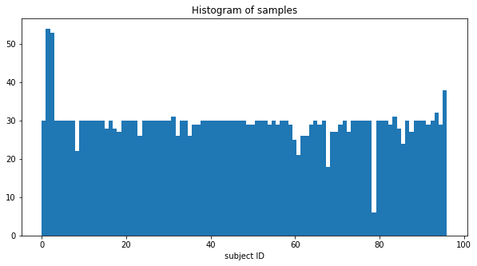
The CASIA-D Dataset
max (54 samples)
Number of samples
Mean (29 samples)
Min (6 samples)
97 subjects
Notes:
slide 24
Here we can see the average of training and test samples for each test set.
The min and max number of samples are shown in parenthesis.

Slide 4
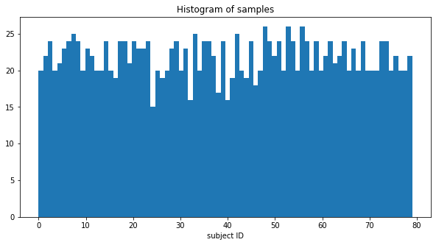
The Stepscan Dataset
max (26 samples)
Mean (21 samples)
Number of samples
Min (15 samples)
80 subjects
Notes:
slide 24
Here we can see the average of training and test samples for each test set.
The min and max number of samples are shown in parenthesis.

Slide 5
Challenges
Imbalanced dataset
The size of the training set

Slide 6
Frameworks
COA and GFR features
ML classifier
Image features
ML classifier
Image features
Pre-trained CNN
Deep features
ML classifier
Footprint samples
Image features
Trained light weight CNN
Deep features
ML classifier
Image features
Tuning Pre-trained CNN
Deep features
ML classifier
Image features
End To End Network
Notes:
In this worksheet, a template matching model for verification task was developed.
The aim of this worksheet is to find the best model based on two different score matrixes.
In addition, we are going to compare COP and COA features.

